Slide 1
Fundamentals of Python: First Programs Second Edition
Chapter 5
Lists and Dictionaries

Slide 2
Objectives (1 of 2)
5.1 Construct lists and access items in those lists
5.2 Use methods to manipulate lists
5.3 Perform traversals of lists to process items in the lists
5.4 Define simple functions that expect parameters and return values

Slide 3
Objectives (2 of 2)
5.5 Construct dictionaries and access entries in those dictionaries
5.6 Use methods to manipulate dictionaries
5.7 Determine whether a list or a dictionary is an appropriate data structure for a given application

Slide 4
Introduction
A list allows the programmer to manipulate a sequence of data values of any types
A dictionary organizes data values by association with other data values rather than by sequential position
Lists and dictionaries provide powerful ways to organize data in useful and interesting applications

Slide 5
Lists
List: Sequence of data values (items or elements)
Some examples:
Shopping list for the grocery store
To-do list
Roster for an athletic team
Guest list for a wedding
Recipe, which is a list of instructions
Text document, which is a list of lines
Names in a phone book
Each item in a list has a unique index that specifies its position (from 0 to length – 1)

Slide 6
List Literals and Basic Operators (1 of 4)
Some examples:
[‘apples’, ‘oranges’, ‘cherries’]
[[5, 9], [541, 78]]
When an element is an expression, its value is included in the list:
>>> import math
>>> x = 2
>>> [x, math.sqrt(x)]
[2, 1.4142135623730951]
>>> [x + 1]
[3]

Slide 7
List Literals and Basic Operators (2 of 4)
Lists of integers can be built using range:
>>> first = [1, 2, 3, 4]
>>> second = list(range(1, 5))
>>> first
[1, 2, 3, 4]
>>> second
[1, 2, 3, 4]
The list function can build a list from any iterable sequence of elements:
>>> third = list(“Hi there!”)
>>> third
[‘H’, ‘I’, ‘ ’ , ‘t’, ‘h’, ‘e’, ‘r’, ‘e’, ‘!’]

Slide 8
List Literals and Basic Operators (3 of 4)
len, [], and == work on lists as expected:
>>> len(first)
4
>>> first[0]
1
>>> first[2:4]
[3, 4]
Concatenation (+) and equality (==) also work as expected for lists:
>>> fourth = first + [5, 6]
>>> fourth
[1, 2, 3, 4, 5, 6]
>>> first == second
True

Slide 9
List Literals and Basic Operators (4 of 4)
To print the contents of a list:
>>> print(“1234”)
1234
>>> print([1, 2, 3, 4])
[1, 2, 3, 4]
in detects the presence of an element:
>>> 3 in [1, 2, 3]
True
>>> 0 in [1, 2, 3]
False

Slide 10
Replacing an Element in a List (1 of 2)
A list is mutable (meaning the subparts of it can be changed)
Elements can be inserted, removed, or replaced
The list itself maintains its identity, but its state—its length and its contents—can change
Subscript operator is used to replace an element:
>>> example = [1, 2, 3, 4]
>>> example
[1, 2, 3, 4]
>>> example[3] = 0
>>> example
[1, 2, 3, 0]
Subscript is used to reference the target of the assignment, which is not the list but an element’s position within it

Slide 11
Replacing an Element in a List (2 of 2)
The first session shows how to replace each number in a list with its square:
>>> numbers = [2, 3, 4, 5]
>>> numbers
[2, 3, 4, 5]
>>> for index in range(len(numbers)):
numbers[index] = numbers[index] ** 2
>>> numbers
[4, 9, 16, 25]
Next session uses the string method split to extract a list of words:
>>> sentence = “This example has five words. ”
>>> words = sentence.split()
>>> words
[‘This’, ‘example’, ‘has’, ‘five’, ‘words.’]
>>> for index in range(len(words)):
words[index] = words[index].upper()
>>> words
[‘THIS’, ‘EXAMPLE’, ‘HAS’, ‘FIVE’, ‘WORDS.’]

Slide 12
List Methods for Inserting and Removing Elements (1 of 4)
The list type includes several methods for inserting and removing elements
List Method | What It Does
L..append(element) | Adds element to the end of L
L.extend(aList) | Adds the elements of aList to the end of L
L..insert(index, element) | Inserts element at index if index is less than the length of L. Otherwise, inserts element at the end of L.
L.pop() | Removes and returns the element at the end of L.
L.pop(index) | Removes and returns the element at index

Slide 13
List Methods for Inserting and Removing Elements (2 of 4)
The method insert expects an integer index and the new element as arguments
>>> example = [1, 2]
>>> example
[1, 2]
>>> example.insert(1, 10)
>>> example
[1, 10, 2]
>>> example.insert(3, 25)
>>> example
[1, 10, 2, 25]

Slide 14
List Methods for Inserting and Removing Elements (3 of 4)
The method append expects just the new element as an argument and adds the new element to the end of the list
The method extend performs a similar operation, but adds the elements of its list argument to the end of the list
>>> example = [1, 2]
>>> example
[1, 2]
>>> example.append(3)
>>> example
[1, 2, 3]
>>> example.extend([11, 12, 13])
>>> example
[1, 2, 3, 11, 12, 13]
>>> example + [14, 15]
[1, 2, 3, 11, 12, 13, 14, 15]
>>> example
[1, 2, 3, 11, 12, 13]

Slide 15
List Methods for Inserting and Removing Elements (4 of 4)
The method pop is used to remove an element at a given position
>>> example
[1, 2, 10, 11, 12, 13]
>>> example.pop() # Remove the last element
13
>>> example
[1, 2, 10, 11, 12]
>>> example.pop(0) # Remove the first element
1
>>> example
[2, 10, 11, 12]

Slide 16
Searching a List
in determines an element’s presence or absence, but does not return position of element (if found). It returns a True or False.
Use method index to locate an element’s position in a list
Raises an error when the target element is not found
aList = [34, 45, 67]
target = 45
if target in aList:
print(aList.index(target))
else:
print(−1)

Slide 17
Sorting a List
A list’s elements are always ordered by position, but you can impose a natural ordering on them
For example, in alphabetical order
When the elements can be related by comparing them <, >, and ==, they can be sorted
The method sort mutates a list by arranging its elements in ascending order
>>> example = [4, 2, 10, 8]
>>> example
[4, 2, 10, 8]
>>> example.sort()
>>> example
[2, 4, 8, 10]

Slide 18
Mutator Methods and the Value None
All of the functions and methods examined in previous chapters return a value that the caller can then use to complete its work
Mutator methods (e.g., insert, append,extend,pop,and sort) usually return no value of interest to caller
Python automatically returns the special value None
>>> aList = aList.sort()
>>> print(aList)
None

Slide 19
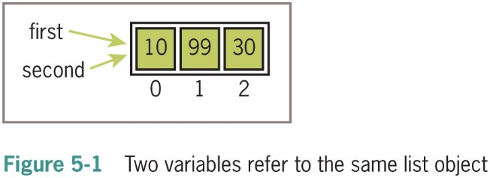
Aliasing and Side Effects (1 of 2)
Mutable property of lists leads to interesting phenomena:
>>> first = [10, 20, 30]
>>> second = first
>>> first
[10, 20, 30]
>>> second
[10, 20, 30]
>>> first[1] = 99
>>> first
[10, 99, 30]
>>> second
[10, 99, 30]
First and second are aliases
They refer to the exact same list object

Slide 20
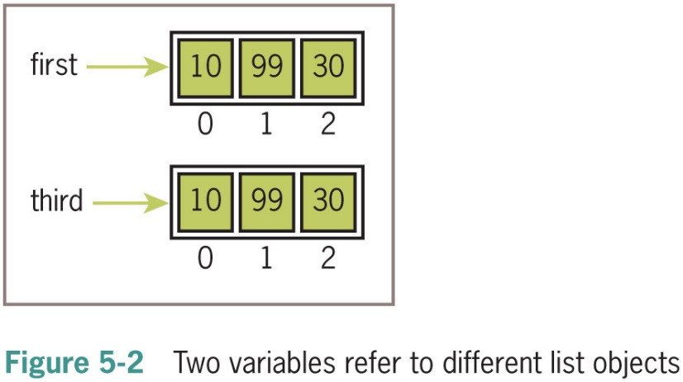
Aliasing and Side Effects (2 of 2)
To prevent aliasing, create a new object and copy contents of original:
>>> third = []
>>> for element in first:
third.append(element)
>>> first
[10, 99, 30]
>>> third
[10, 99, 30]
>>> first[1] = 100
>>> first
[10, 100, 30]
>>> third
[10, 99, 30]

Slide 21
Equality: Object Identity and Structural Equivalence (1 of 2)
Programmers might need to see whether two variables refer to the exact same object or to different objects
Example, you might want to determine whether one variable is an alias for another
The == operator returns True if the variables are aliases for the same object.
Unfortunately, == also returns True if the contents of two different objects are the same
The first relation is called object identity
The second relation is called structural equivalence.
The == operator has no way of distinguishing between these two types of relations.

Slide 22
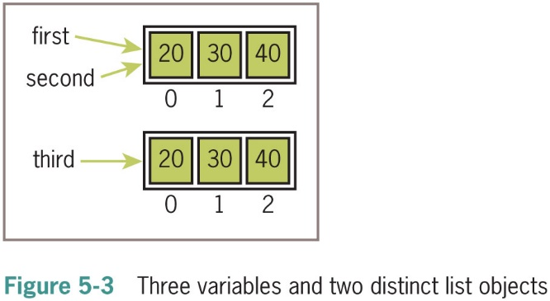
Equality: Object Identity and Structural Equivalence (2 of 2)
Python’s is operator can be used to test for object identity
>>> first = [20, 30, 40]
>>> second = first
>>> third = list(first) # Or first[:]
>>> first == second
True
>>> first == third
True
>>> first is second
True
>>> first is third
False

Slide 23
Example: Using a List to Find the Median of a Set of Numbers
To find the median of a set of numbers:
“““
File: median.py
Prints the median of a set of numbers in a file.
”””
fileName = input(“Enter the filename: ”)
f = open(fileName, ‘r’)
# Input the text, convert it to numbers, and
# add the numbers to a list
numbers = []
for line in f:
words = line.split()
for wd in words:
numbers.append(float(word))
# Sort the list and print the number at its midpoint
numbers.sort()
midpoint = len(numbers) // 2
print(“The median is’’, end = “ ”)
if len(numbers) % 2 == 1:
print(numbers[midpoint])
else:
print((numbers[midpoint] + numbers[midpoint − 1]) / 2)

Slide 24
Tuples
A tuple resembles a list, but is immutable
Indicate by enclosing its elements in ()
>>> fruits = (“apple”, “banana”)
>>> fruits
(‘apple’, ‘banana’)
>>> meats = (“fish”, “poultry”)
>>> meats
(‘fish’, ‘poultry’)
>>> food = meats + fruits
>>> food
(‘fish’, ‘poultry’, ‘apple’, ‘banana’)
>>> veggies = [“celery”, “beans”]
>>> tuple(veggies)
(‘celery’, ‘beans’)

Slide 25
Defining Simple Functions
Defining our own functions allows us to organize our code in existing scripts more effectively
This section provides a brief overview of how to do this

Slide 26
The Syntax of Simple Function Definitions
Definition of a function consists of header and body
def square(x):
“““Returns the square of x.”””
return x * x
Docstring contains information about what the function does; to display, enter help(square)
A function can be defined in a Python shell, but it is more convenient to define it in an I D L E window
Syntax of a function definition:
def <function name>(<parameter−1>, ..., <parameter−n>):
<body>

Slide 27
Parameters and Arguments
A parameter is the name used in the function definition for an argument that is passed to the function when it is called
For now, the number and positions of arguments of a function call should match the number and positions of the parameters in the definition
Some functions expect no arguments
They are defined with no parameters

Slide 28
The Return Statement
Place a return statement at each exit point of a function when function should explicitly return a value
Syntax:
return <expression>
If a function contains no return statement, Python transfers control to the caller after the last statement in the function’s body is executed
The special value None is automatically returned

Slide 29
Boolean Functions
A Boolean function usually tests its argument for the presence or absence of some property
Returns True if property is present; False otherwise
Example:
>>> odd(5)
True
>>> odd(6)
False
def odd(x):
“““ Returns True if x is odd or False otherwise.”””
if x % 2 == 1:
return True
else:
return False

Slide 30
Defining a Main Function (1 of 2)
main serves as the entry point for a script
Usually expects no arguments and returns no value
Definition of main and other functions can appear in no particular order in the script
As long as main is called at the end of the script
Script can be run from I D L E, imported into the shell, or run from a terminal command prompt

Slide 31
Defining a Main Function (2 of 2)
Example:
“““
File: computesquare.py
Illustrates the definition of a main function.
”””
def main():
“““ The main function for this script.”””
number = float(input(“Enter a number: ”))
result = square(number)
print(“The square of”, number, “is”, result)
def square(x):
“““Returns the square of x.”””
return x * x
# The entry point for program execution
if __name__ == “__main:”__
main()

Slide 32
Dictionaries
A dictionary organizes information by association, not position
Example: When you use a dictionary to look up the definition of “mammal,” you don’t start at page 1; instead, you turn to the words beginning with “M”
Data structures organized by association are also called tables or association lists
In Python, a dictionary associates a set of keys with data values

Slide 33
Dictionary Literals
A Python dictionary is written as a sequence of key/value pairs separated by commas
Pairs are sometimes called entries
Enclosed in curly braces ({ and })
A colon (:) separates a key and its value
Examples:
A phone book: {‘Savannah’:‘476-3321’, ‘Nathaniel’:‘351-7743’}
Personal information: {‘Name’:‘Molly’, ‘Age’:18}
An empty dictionary: {}
Keys in a dictionary can be data of any immutable types, including other data structures
They are normally strings or integers

Slide 34
Adding Keys and Replacing Values
Add a new key/value pair to a dictionary using []:
<a dictionary>[<a key>] = <a value>
Example:
>>> info = {}
>>> info[“name”] = “Sandy”
>>> info[“occupation”] = “hacker”
>>> info
{‘name’:‘Sandy’, ‘occupation’:‘hacker’}
Use [] also to replace a value at an existing key:
>>> info[“occupation”] = “manager”
>>> info
{‘name’:‘Sandy’, ‘occupation’: ‘manager’}

Slide 35
Accessing Values (1 of 2)
Use [] to obtain the value associated with a key
If key is not present in dictionary, an error is raised
>>> info[“name”]
‘Sandy’
>>> info[“job”]
Trace back (most recent call last):
File “<py shell#1>”, line 1, in <module>
info[“job”]
Key Error: ‘job’

Slide 36
Accessing Values (2 of 2)
If the existence of a key is uncertain, test for it using the dictionary method has_key
Easier strategy is to use the method get
>>> if “job” in info:
print(info.[“job”])

Slide 37
Removing Keys
To delete an entry from a dictionary, remove its key using the method pop
pop expects a key and an optional default value as arguments
>>> print(info.pop(“job”, None))
None
>>> print(info.pop(“occupation”))
manager
>>> info
{‘name’:‘Sandy’}

Slide 38
Traversing a Dictionary (1 of 3)
To print all of the keys and their values:
for key in info:
print(key, info[key])
Alternative: Use the dictionary method items()
>>> grades = {90:‘A’, 80:‘B’, 70:‘C’}
>>> list(grades.items())
[(80, ‘B’), (90,‘A’), (70,‘C’)]
Entries are represented as tuples within the list
for (key, value) in grades.items():
print(key, value)

Slide 39
Traversing a Dictionary (2 of 3)
You can sort the list first then traverse it to print the entries of the dictionary in alphabetical order:
the Keys = list(info.keys())
the Keys.sort()
for key in the Keys:
print(key, info[key])

Slide 40
Traversing a Dictionary (3 of 3)
Dictionary Operation | What It Does
len(d) | Returns the number of entries in d
d[key] | Used for inserting a new key, replacing a value, or obtaining a value at an existing key
d.get(key [, default]) | Returns the value if the key exists or returns the default if the key does not exist
d.pop(key [, default]) | Removes the key and returns the value if the key exists or returns the default if the key does not exist
list(d.keys()) | Returns a list of the keys
list(d.values()) | Returns a list of the values
list(d.items()) | Returns a list of tuples containing the keys and values for each entry
d.clear() | Removes all the keys
for key in d: | key is bound to each key in d in an unspecified order

Slide 41
Example: The Hexadecimal System Revisited (1 of 2)
You can keep a hex-to-binary lookup table to aid in the conversion process
hexToBinaryTable = {‘0’:‘0000’, ‘1’:‘0001’, ‘2’:‘0010’,
‘3’:‘0011’, ‘4’:‘0100’, ‘5’:‘0101’,
‘6’:‘0110’, ‘7’:‘0111’, ‘8’:‘1000’,
‘9’:‘1001’, ‘A’:‘1010’, ‘B’:‘1011’,
‘C’:‘1100’, ‘D’:‘1101’, ‘E’:‘1110’,
‘F’:‘1111’}

Slide 42
Example: The Hexadecimal System Revisited (2 of 2)
The function convert expects two parameters: a string representing the number to be converted and a table of associations of digits
Example:
def convert(number, table):
“““Builds and returns the base two representation of
number.”””
binary = “ ”
for digit in number:
binary = table[digit] + binary
return binary
>>> convert(“35A”, hexToBinaryTable)
‘001101011010’

Slide 43
Example: Finding the Mode of a List of Values (1 of 2)
The mode of a list of values is the value that occurs most frequently
The following script inputs a list of words from a text file and prints their mode
fileName = input(“Enter the filename:”)
f = open(fileName, ‘r’)
# Input the text, convert its words to uppercase, and
# add the words to a list
words = []
for line in f:
for word in line.split():
words.append(word.upper())

Slide 44
Example: Finding the Mode of a List of Values (2 of 2)
# Obtain the set of unique words and their
# frequencies, saving these associations in
# a dictionary
theDictionary = {}
for word in words:
number = theDictionary.get(word, None)
if number == None:
# word entered for the first time
theDictionary[word] = 1
else:
# word already seen, increment its number
theDictionary[word] = number + 1
# Find the mode by obtaining the maximum value
# in the dictionary and determining its key
theMaximum = max(theDictionary.values())
for key in theDictionary:
if theDictionary[key] == theMaximum:
print(“The mode is”, key)
break

Slide 45
Chapter Summary (1 of 2)
A list is a sequence of zero or more elements
Can be manipulated with the subscript, concatenation, comparison, and in operators
Mutable data structure
index returns position of target element in a list
Elements can be arranged in order using sort
Mutator methods are called to change the state of an object; usually return the value None
Assignment of a variable to another one causes both to refer to the same data object (aliasing)

Slide 46
Chapter Summary (2 of 2)
A tuple is similar to a list, but is immutable
A function definition consists of header and body
return returns a value from a function definition
The number and positions of arguments in a function call must match the number and positions of required parameters specified in the function’s definition
A dictionary associates a set of keys with values
[] is used to add a new key/value pair to a dictionary or to replace a value associated with an existing key
dict type includes methods to access and remove data in a dictionary
Testing can be bottom-up, top-down, or you can use a mix of both

